Slide 1
AGENDA
OSI Model Block Diagram
OSI Encapsulation Process
Application Protocol Design
Application Layer Protocols
HTTP(Hypertext Transfer Protocol)
DNS(Domain Name System)
FTP(File Transfer Protocol)
SMTP(Simple Mail Transfer Protocol)
SNMP
WWW
Summary
References

Slide 2
APPLICATION PROTOCOL DESIGN
Think of different people/teams working on the client and server programs.
Different programming languages.
Diverse hardware and operating systems.
Be unambiguous, precise.
Consider potential sources of error.
Allow for future extensions.
Leave room for additional data, meta-data like checksum
Do not replicate services provided by lower layer protocols

Slide 3
APPLICATION LAYER PROTOCOLS
An application layer protocol defines how application processes (clients and servers), running on different end systems, pass messages to each other.
In particular, an application layer protocol defines:
The types of messages like request messages and response messages
The syntax of the various message types, i.e. the fields in the message and how the fields are delineated
The semantics of the fields i.e. the meaning of the information that the field is supposed to contain
Rules for determining when and how a process sends messages and responds to messages.

Slide 4
CONTINUED..
Many Internet application-layer protocols are fully specified in Request For Comments documents (RFCs) and are therefore in the public domain.
For example, the HTTP 1.1 specification is included in RFC 2068, which was finalized and made public in January 1997.
If a browser (HTTP client) developer follows the rules of the HTTP
1.1 RFC, the browser will be able to retrieve Web pages from any Web server that has also has followed the rules of the HTTP 1.1 RFC.

Slide 5
Types of Application Layer Protocols
Application layer protocols are as follows:
HTTP(Hypertext Transfer Protocol)
DNS(Domain Name System)
FTP(File Transfer Protocol)
SMTP(Simple Mail Transfer Protocol)
www (world wide web)

Slide 6
2. DNS
HOSTNAMES:
IP address includes information used for routing.
IP addresses are tough for humans to remember or guess.
The Domain Name System:
The domain name system is usually used to translate a host name into an IP address.
Domain names comprise a hierarchy so that names are unique,
yet easy to remember.

Slide 7
DNS Hierarchy
Idk
edu com org jp
rpi albany

Slide 8
CONTINUED..
Host name structure:
Each host name is made up of a sequence of labels separated by
periods.
Each label can be up to 63 characters
The total name can be of at most 255 characters.
Examples: whitehouse.gov, monica.cs.rpi.edu etc
Domain Name
The domain name for a host is the sequence of labels that lead from the host (leaf node in the naming tree) to the top of the worldwide naming tree.
A domain is a subtree of the world wide naming tree.

Slide 9
CONTINUED..
Top level domains:
edu, gov, com, net, org, mil, …
All countries have a top level domain (2 letter domain name)
New top level domains include: .aero, .biz, .coop, .info, .name, .pro etc
DNS Organization
Distributed Database
The organization that owns a domain name is responsible for running a DNS server that can provide the mapping between hostnames within the domain to IP addresses.
So some machine run by RPI is responsible for everything within
the rpi.edu domain.
17

Slide 10
CONTINUED..
DNS Clients:
A DNS client is called a resolver.
A call to getByName (host) is handled by a resolver.
Most Unix workstations have the file /etc/resolv.conf that contains the local domain and the addresses of DNS servers for that domain.
Nslookup:
Nslookup is an interactive resolver that allows the user to communicate directly with a DNS server.
Nslookup is usually available on Unix workstations.

Slide 11
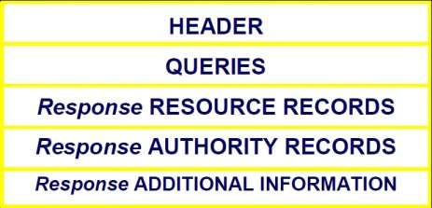
CONTINUED..
DNS Servers:
Servers handle requests for their domain directly.
Servers handle requests for other domains by contacting remote DNS server(s).
Servers cache external mappings.
DNS Message Format:

Slide 12
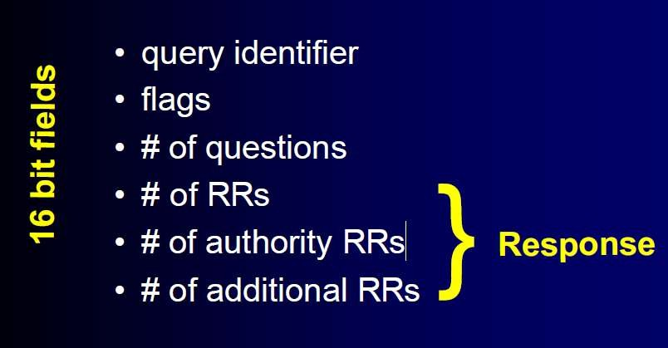
CONTINUED..
DNS Message Header:
20

Slide 13
INTRODUCTION
HTTP has been in use by the World-Wide Web global information initiative since 1990.
Protocol used for communication between web browsers (clients) and web servers.
Popular Web servers:
Apache HTTPD
JBoss
Tomcat
Popular Web clients:
Firefox
Opera
wget

Slide 14
WHY STUDY HTTP ?
Understand the interaction between web clients and web servers
Manually query web servers and receive low-level information that typical web browsers hide from the user
Understand the configuration and capabilities of a particular server
Debug configuration errors with the server or programming errors in programs invoked by the web server
Streamline web services to make better use of the protocol.

Slide 15
EVOLUTIONS
HTTP 0.9 (1991)
HTTP 1.0 (1996)
HTTP 1.1 (1997)

Slide 16
OTHER APPLICATION LAYER PROTOCOLS USED ON THE INTERNET
Protocol | Application
HTTP: Hypertext Transfer | Retrieve and view Web pages
FTP: File Transfer | Copy files from client to server or from server to client
SMTP: Simple Mail Transfer | Send email
POP: Post Office | Read email

Slide 17
AN HTTP CONVERSATION
Please delete this slide
Idk i’ve lost my mind
Like i need help smh
Client Server
I would like to open a connection
OK
GET <file location>
Send page or error message
Display response
Close connection
OK
HTTP is the set of rules governing the format and content of the conversation between a Web client and server

Slide 18
AN HTTP EXAMPLE
The message requesting a Web page must begin with the work “GET” and be followed by a space and the location of a file on the server, like this:
GET /fac/lpress/shortbio.htm
The protocol spells out the exact message format, so any Web client can retrieve pages from any Web server.

Slide 19
BASIC OPERATION
IMPOSSIBLE, DELETE
Client
Server
Request Method URL / RelativeURL Request Headers Request Body
Protocol Version Status Code Response Headers Response Body

Slide 20





HTTP TRANSACTIONS
Requests
Given the following URL: http://www.google.com:80/ the browser interprets the URL as follows:
http://
Use HTTP, the Hypertext Transfer Protocol.
www.google.com
Contact a computer over the network with the hostname of www.google.com.
:80
Connect to the computer at port 80. The port number can be any
legitimate IP port number: 1 through 65535,
/
Anything after the hostname and optional port number is regarded as a document path. In this example, the document path is /.

Slide 21

HTTP REQUEST
Format:
Method URI HttpVersion
Method | Description
OPTIONS | capabilities of resource/server
GET | retrieve resource
HEAD | retrieve headers for resource
POST | submit data to server
PUT | replace/insert resource on server
DELETE | remove resource from server
TRACE | trace request route through Web

Slide 22
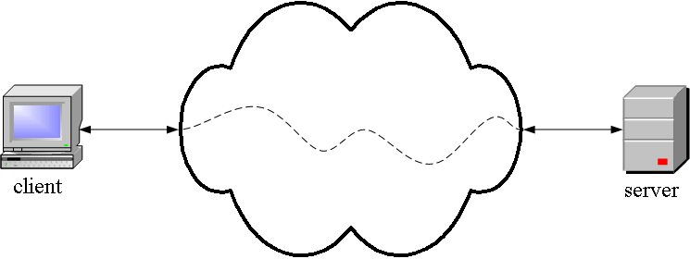
HTTP IS AN APPLICATION LAYER PROTOCOL
The Web client and the Web server are application programs
Application layer programs do useful work like retrieving Web pages, sending and receiving email or transferring files
Lower layers take care of the communication details
The client and server send messages and data without knowing anything about the communication network

Slide 23
URLS, URNS AND URIS
Every resource accessible through HTTP is identified by a Uniform Resource Location (URL), which is a location-specific identifier.
Example: http://www.cs.uct.ac.za:80/
A Uniform Resource Identifier (URI) is a standard format
(<scheme>:<identifier>) generic identifier.
Example: mailto:hussein@cs.uct.ac.za
A Uniform Resource Name (URN) is one example of a location-independent URI.
Example: urn:isbn:123-456-789
Note: Every URL and URN is also a URI!

Slide 24
OTHER HTTP FEATURES
Authentication
Persistent connections
GET-if-modified
Byte ranges
Content type negotiation
Cache control
Proxy support

Slide 25
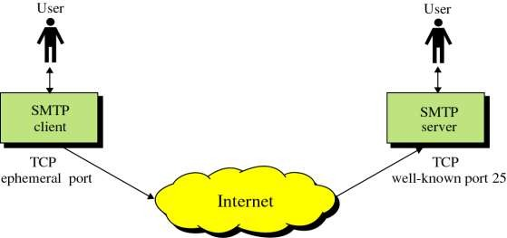
SIMPLE MAIL TRANSFER PROTOCOL (SMTP)
This protocol originated in 1982 (RFC821, Jon Postel)
Standard message format (RFC822,2822, D. Crocker)
The objective was to transfer mail reliably and efficiently

Slide 26
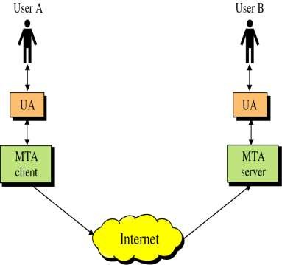
CONTINUED..
SMTP clients and servers have two
main components:
User Agents – Prepares the message, encloses it in an envelope. (ex. Thunderbird, Eudora)
Mail Transfer Agent – Transfers the mail across the internet (ex. Sendmail, Exim)
Analogous to the postal system in many ways

Slide 27
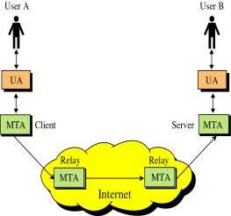
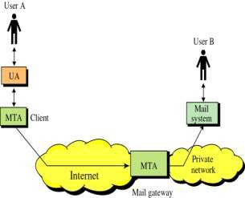
CONTINUED..
SMTP also allows the use of Relays allowing other MTAs to relay the mail.
Mail Gateways are used to relay mail prepared by a protocol other than SMTP and convert it to SMTP.

Slide 28
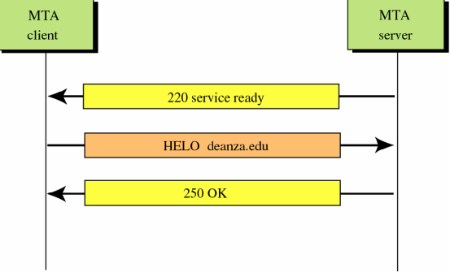
CONTINUED..
Connection establishment:
33

Slide 29
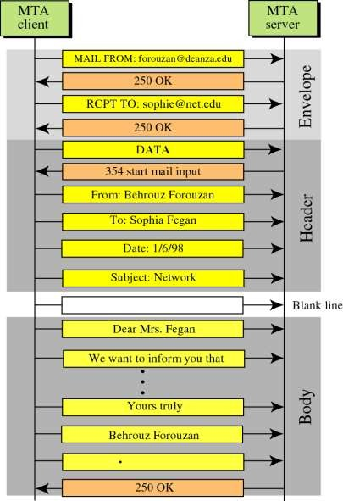
CONTINUED...
Message Progress:

Slide 30
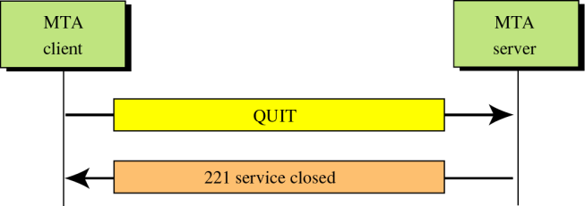
CONTINUED..
Connection Termination:
TCP Connection Termination

Slide 31
CONTINUED..
Limitations of SMTP:
Only uses NVT 7 bit ASCII format
Problem of representing other data types
No authentication mechanisms
Messages are sent without encryptions
Susceptible to misuse (spamming, faking sender address)

Slide 32
SUMMARY
OSI model has 7 layers. In particular, an application layer protocol defines the types of messages, e.g. request messages and response messages.
Application layer has 6 protocols:
HTTP(Hypertext Transfer Protocol)
DNS(Domain Name System)
FTP(File Transfer Protocol)
TELNET
DHCP(Dynamic Host Configuration Protocol)
SMTP(Simple Mail Transfer Protocol)

Slide 33
REFERENCES
Web Sites:
http://www.faqs.org/rfcs/rfc821.html (RFC 821).
http://www.faqs.org/rfcs/rfc2821.html (RFC 2821)
http://www.tcpipguide.com/free/t_SMTPSpecialFeaturesCapabilitiesandExtensions.html
http://cns.utoronto.ca/usg/technotes/smtp-intro.html
http://computer.howstuffworks.com/email5.htm
Books:
Programmer's Guide to Internet Mail by John Rhoton
TCP/IP Illustrated Volume 1 by Richard Stevens

Slide 34
INTRODUCTION TO SNMP
○ SNMP
○ What is SNMP?
○ SNMP Architecture
○ SNMP
Components
○ Versions of SNMP
○ Trap Event

Slide 35
WHAT IS SNMP?
Simple Network Management Protocol (SNMP) is an Internet standard protocol.
It is defined by IETF, Internet Engineering Task Force. It is an application layer protocol.
It manages devices on IP networks. Devices that typically support SNMP include routers, switches, servers, workstations, printers, modem racks and more. It is used mostly in network management.
SNMP is an application program that allows manager to retrieve value of an object defined in agent, a manager to store value in an object defined in agent, an agent to send alarm information called trap event.
○

Slide 36
SNMP ARCHITECTURE
○ Manager
○ Agent
○ NMS(network management Systems)

Slide 37
SNMP ARCHITECTURE
○ SNMP defines manager, its monitored and managed devices connected to the network.
○ Manager sends request to network device called agent and agent responds to manager request via SNMP.
○ Agents will respond data on managed systems as variables.

Slide 38
SNMP ARCHITECTURE
NMS, network management system executes application which monitor and manage devices. Basically it runs on the manager

Slide 39
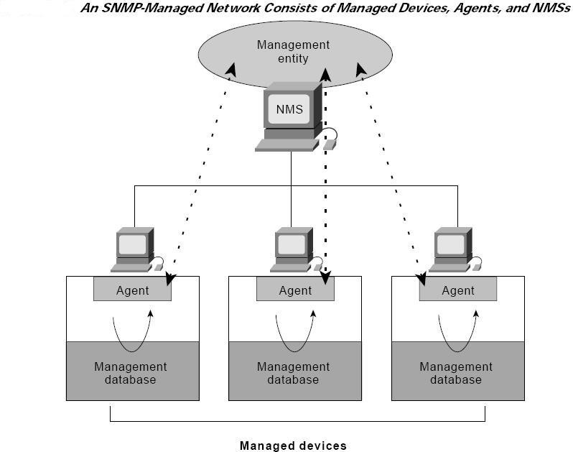

Slide 40
SNMP COMPONENTS
○ Management information base (MIB)
○ Structure of management information (SMI)

Slide 41
○ SNMP provides information about devices and that variable’s information is provided by Management Information Base (MIB). It is a collection of objects and their types in hierarchical tree format.
MIB

Slide 42
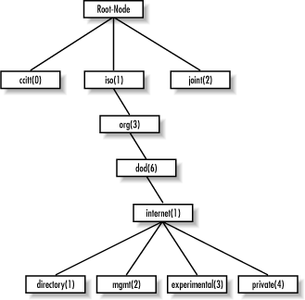

Slide 43
SMI
SMI defines the rule for naming objects, defining object types and showing how to encode objects and data.
It manages devices on IP networks. Devices that typically support SNMP include routers, switches, servers, workstations, printers, modem racks and more. It is used mostly in network management.
SNMP is an application program that allows the manager to retrieve value of an object defined in agent, a manager to store value in an object defined in agent, an agent to send alarm information called trap event.

Slide 44

SNMP VERSIONS & PDU
SNMPv1
SNMPv2 (SNMPv2P, SNMPv2C, SNMPv2u)
SNMP has protocol data units(PDUs),
GetRequest SetRequest Getnextrequest
GetBulkrequest (SNMPv2) Response
Trap InformRequest(SNMPv2)

Slide 45
○ SNMPv1
V1 is first version of SNMP basically has poor security.
○ SNMPv2
V2 is revised version of V1 it improves in area of performance, security, confidentially. It introduces Getbulkrequest & inform Request

Slide 46
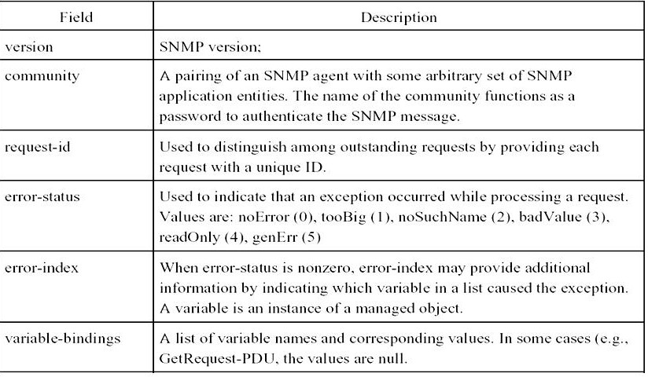
SNMP MESSAGE FIELDS

Slide 47
➢
Get Request
Manager to agent request to retrieve the value of variable. Agent will respond with requested variable with current stored value.
SetRequest
Manager to agent request to change value of variable. Variable bindings are defined in request. Agent will respond with new value.
GetNextRequest
Manager to agent request to discover available variables and their values.
Agent will respond with value of next variable.
GetBulkRequest
it request multiple iterations of GetNextRequest. Returns the response with multiple variable bindings in request.
Response
returns value as requested from agent to manager. It used as response to set and get request.
Trap
It is an notification event , agent to manager which is not requested by manager. Agent itself informing to manager.
Inform request
It is manger to manger communication, one manager can send some information to another manager using informRequest PDU receiving manger response with Response PDU to manger confirming receipt of manager
➢
➢
➢
➢
➢
➢

Slide 48
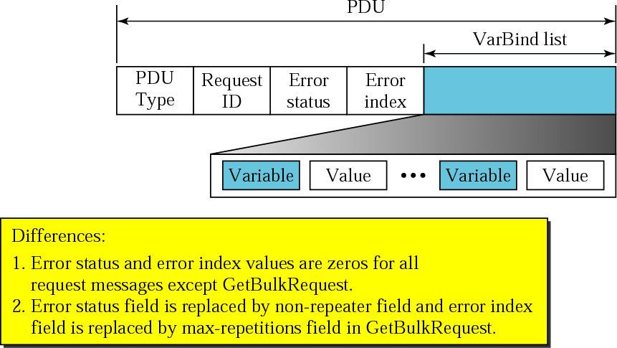

Slide 49
○
○
○
○
○
○
○
○
○
○
○
○
○
○
○
○
○
○
SNMPv2 error-status
===============
noError tooBig genErr wrongValue
wrongEncoding wrongType wrongLength inconsistentValue noAccess notWritable noCreation inconsistentName resourceUnavailable commitFailed undoFailed authorizationError
SNMPv1 error-status
==================
noError tooBig genErr badValue badValue badValue badValue badValue noSuchName noSuchName noSuchName noSuchName genErr genErr genErr noSuchName

Slide 50
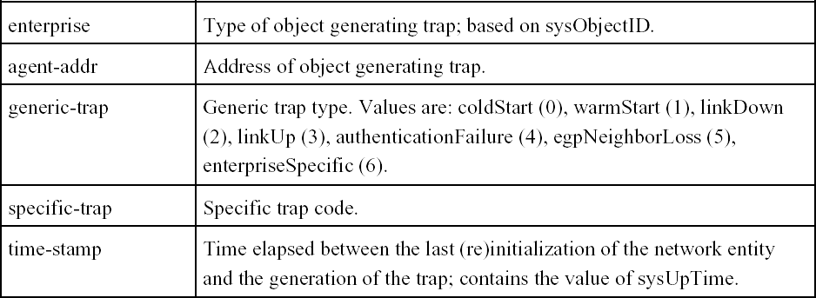
TRAP-PDU

Slide 51
○ A SYSUPTIME PARAMETER (TIMETICKS). THIS APPEARS IN THE FIRST VARIABLE-BINDING IN AN SNMPV2-TRAP-PDU OR INFORMREQUEST-PDU.
○ An snmpTrapOID parameter (OBJECT IDENTIFIER).
This appears in the second variable-binding in an SNMPv2-Trap-PDU or InformRequest-PDU.
○
A list of variable-bindings (VarBindList). This refers to all but the first two variable-bindings in an SNMPv2-Trap- PDU or InformRequest-PDU

Slide 52
TRAPV1
Contains agent address.
It has information about specific trap and generic trap value.
It does not have error index and status
TRAPV2
Does not contain agent address.
It has Trap OID in the second varbind.
It has error index and status.

Slide 53

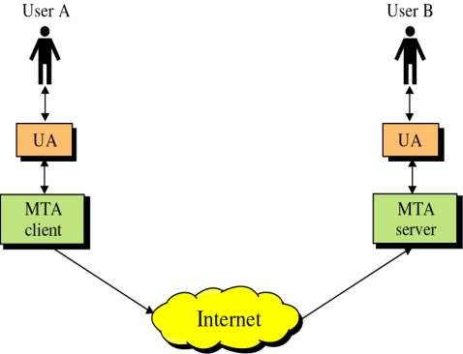
INTRODUCTION
SMTP clients and servers have two main components
User Agents – Prepares the message, encloses it in an envelope. (ex. Thunderbird, Eudora)
Mail Transfer Agent – Transfers the
mail across the internet (ex.
Sendmail, Exim)
Analogous to the postal system in many ways

Slide 54








HOW MESSAGES ARE SENT TO SMTP SERVER?
🞭
E-mail communication using Relaying
Used during initial days of SMTP.
SMTP routing information is included along with E-mail address.
Problem with this method.
🞭
Using DNS
This method is used at present.
The senders SMTP server makes the use of DNS to find MX record of the domain to which the E-mail is to be sent.

Slide 55
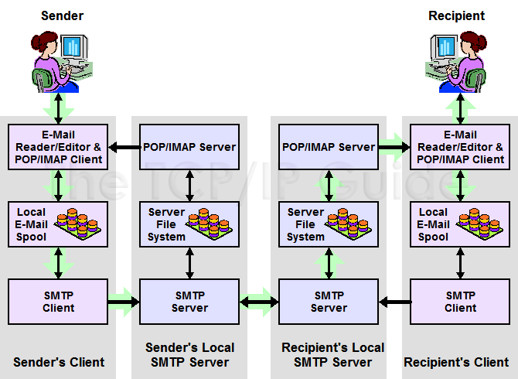
SMTP COMMUNICATION MODEL

Slide 56

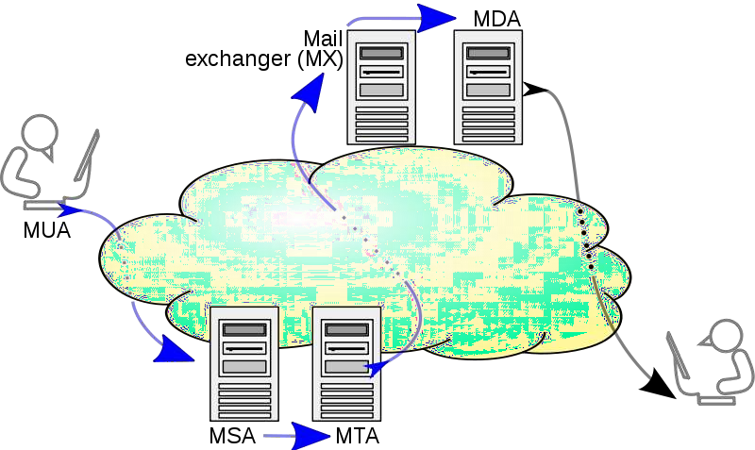
MAIL PROCESSING MODEL

Slide 57
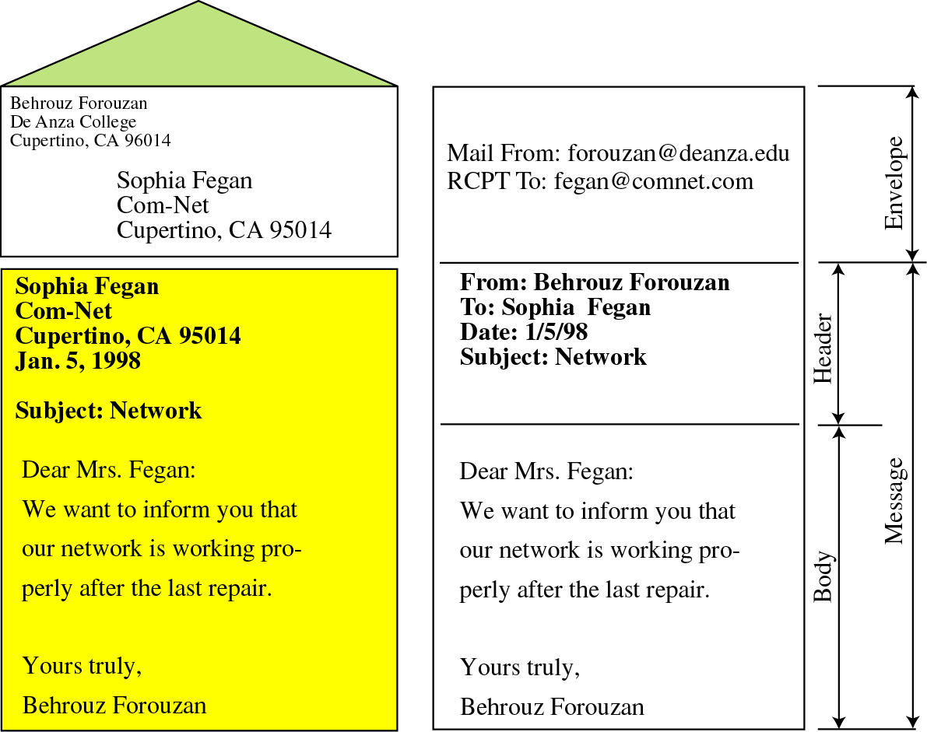
🞭 MAIL IS A TEXT FILE
🞭 ENVELOPE –
🞤 sender address
🞤 receiver address
🞤 other information
🞭 Message –
🞤 Mail Header – defines the sender, the
receiver, the subject of the message, and other information
🞤 Mail Body – Contains the actual information in the message

Slide 58
🞭 STATUS CODES
The Server responds with a 3 digit code that may be followed by text info
2## - Success
3## - Command can be accepted with more information
4## - Command was rejected, but error condition is temporary
5## - Command rejected, Bad User!

Slide 59
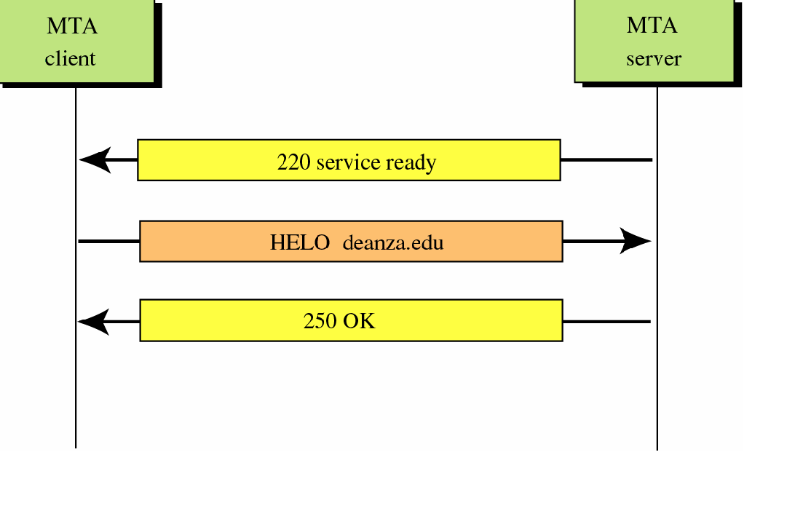
CONNECTION ESTABLISHMENT

Slide 60
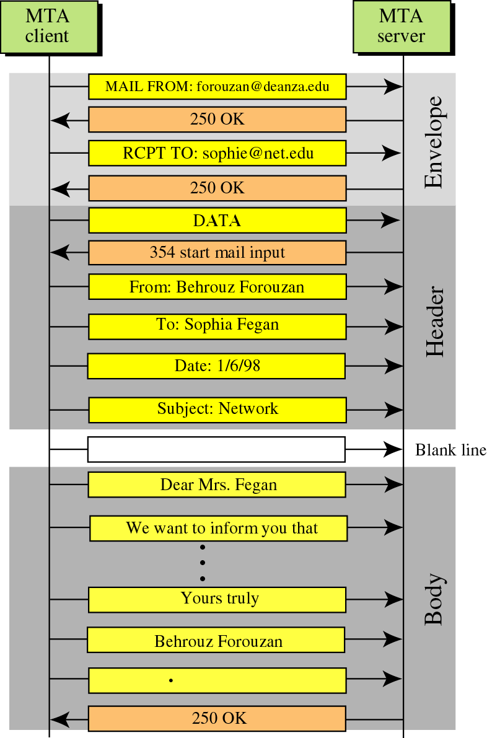

MESSAGE PROGRESS

Slide 61


CONNECTION TERMINATION
TCP Connection Termination

Slide 62














SPECIAL FEATURES
🞭 Mail Forwarding: SMTP server may agree to accept e-mail for
non-local mailbox and forward it to the appropriate
destination.
🞭 Mail Gatewaying: SMTP servers can be implemented as e-
mail gateways which can translate TCP/IP email in a suitable
form for some another e-mail system and vice-versa.
one server to another, as explained earlier, provided certain
🞭 Mail Relaying: SMTP includes the ability to relay mail from
conditions are met.
🞭 Address Debugging: VRFY command allows the client to ask
the sender to verify address of recipient without sending
mail to recipient.
🞭 Mailing List Expansion: EXPN command allows to expand
mailing list.

Slide 63







LIMITATIONS
Security matters for SMTP are worse.
Its usefulness is limited by its simplicity.
Transmission of executable files and binary files using SMTP is not possible without converting into text files. Use MIME to send mail in other format.
It cannot transmit text data that contains national language characters. These national language characters use 8-bit codes with values of 128 decimal or more.
It is limited to 7-bit ASCII characters only.
SMTP servers may reject mail messages beyond some specific length.

